Slide 1
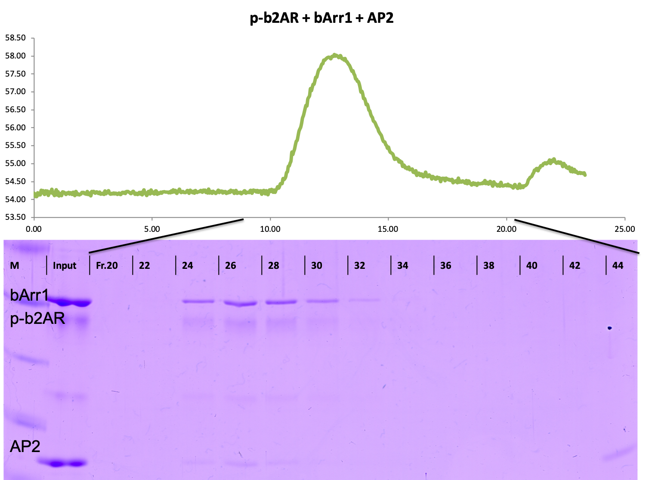
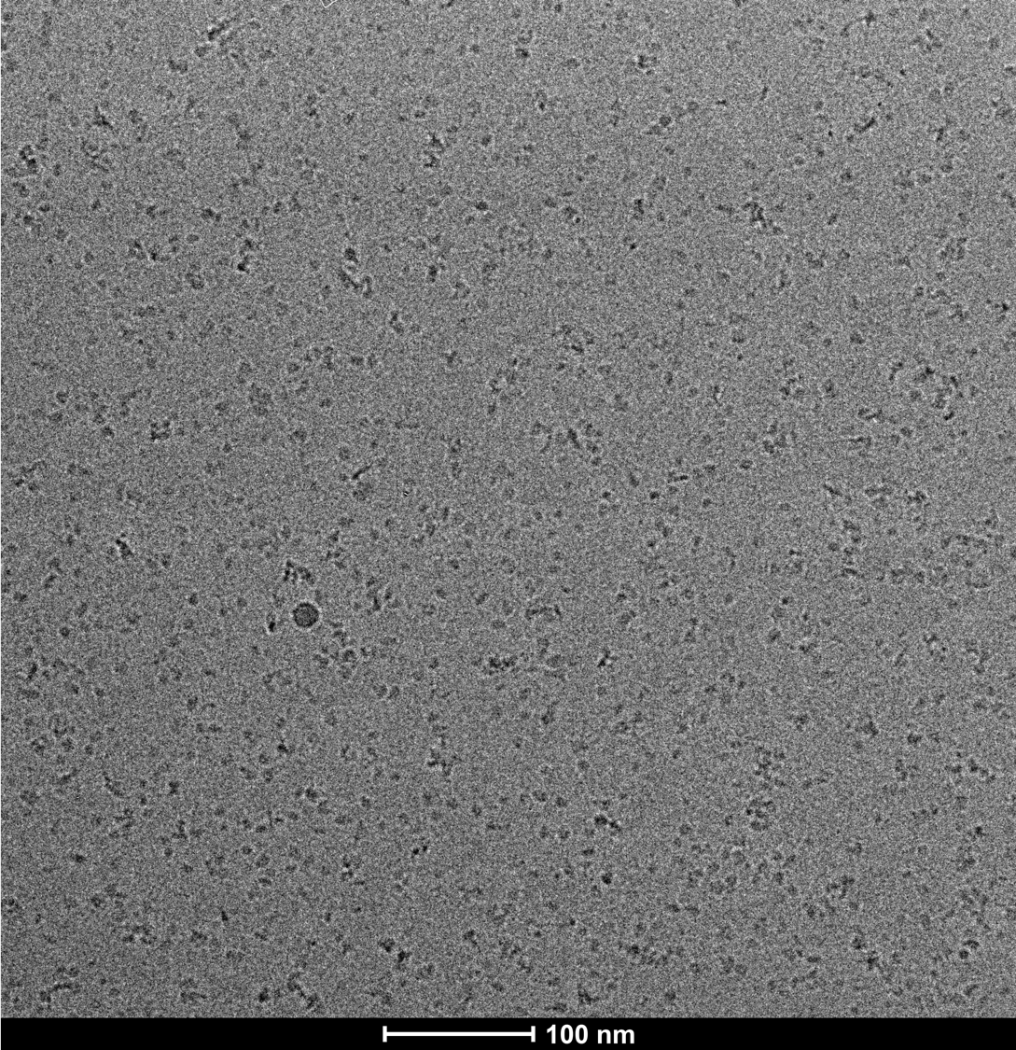
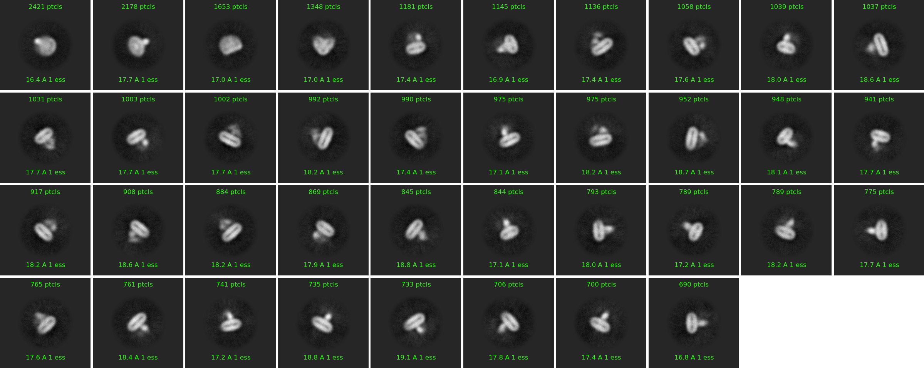
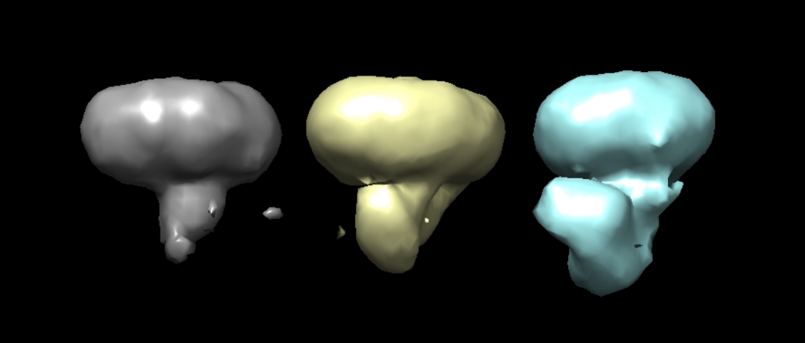
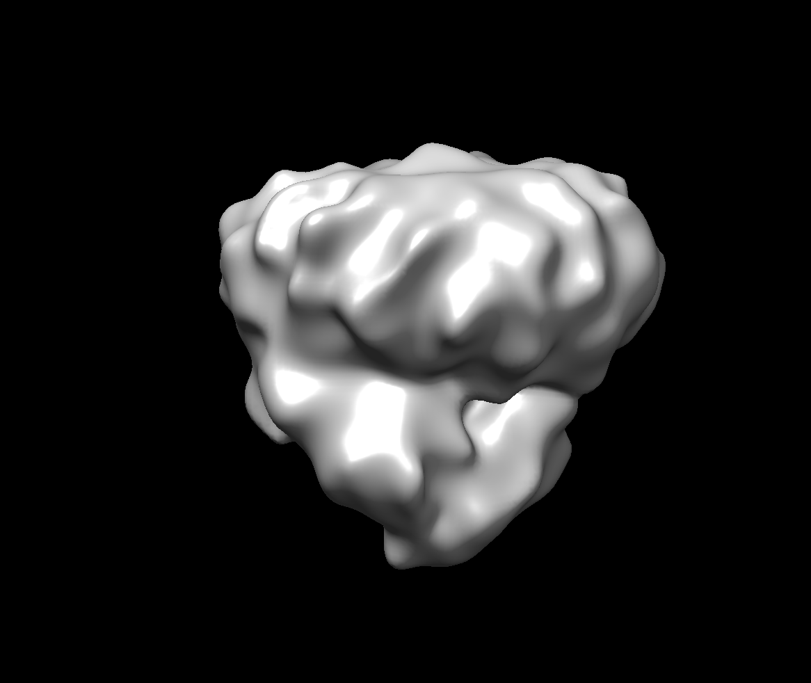
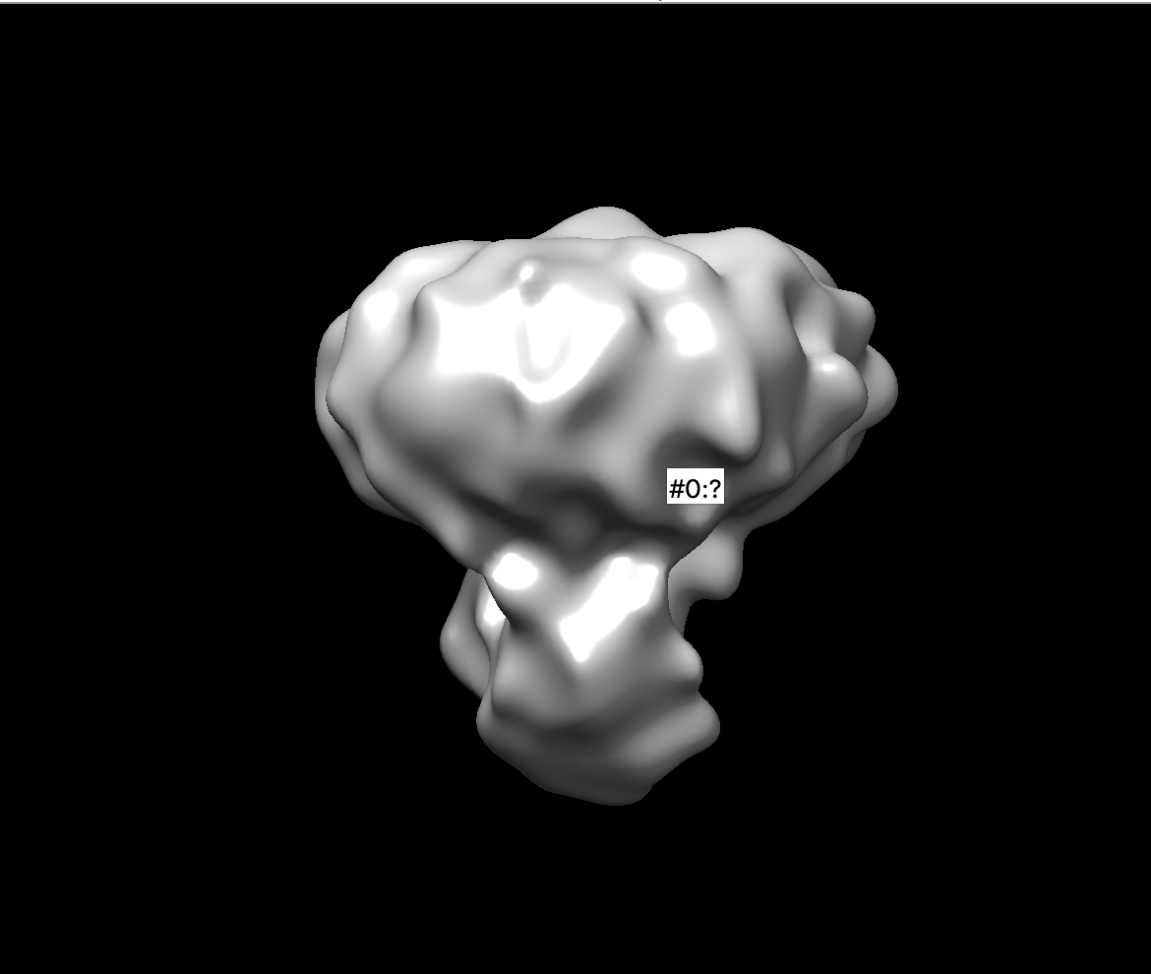
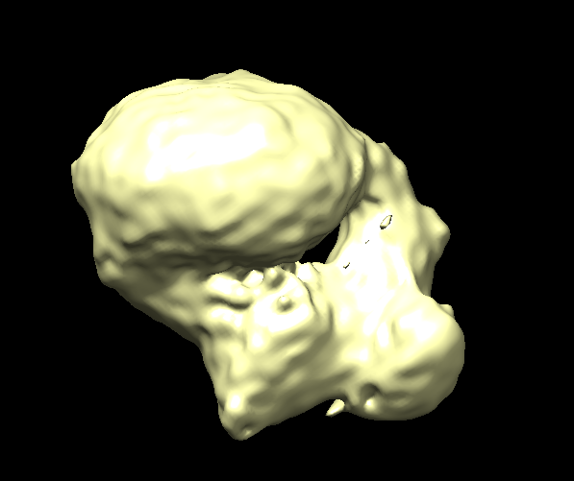
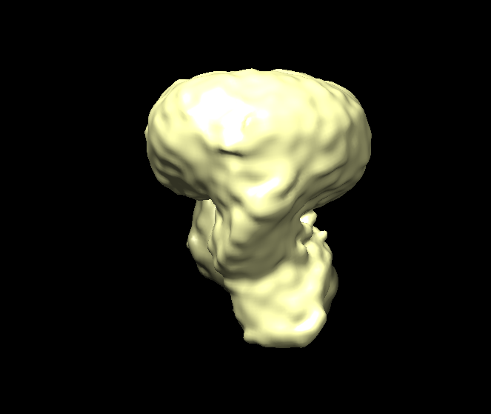
A.
B.
C.
D.
SEC profile of the b2AR/bArr1/AP2 complex elution.
Representative image micrographs used for picking particles. 2D class averages of the complex b2AR/bArr1 in the presence of AP2.
ab initio 3D models generated by cryosparc, which seem to represent 3 classes; receptor alone(micelle), receptor with arrestin bound, receptor with arrestin bound to AP2 endocytic protein.
(Top) Refined low-resolution 3D models of receptor bound to arrestin. (Bottom) Refined low-resolution 3D models of receptor bound to arrestin with AP2.

