Slide 1
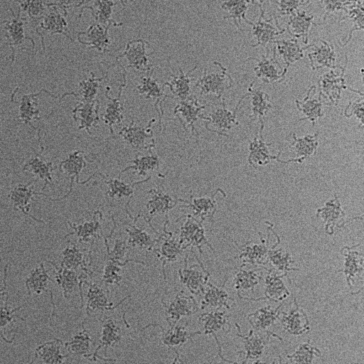
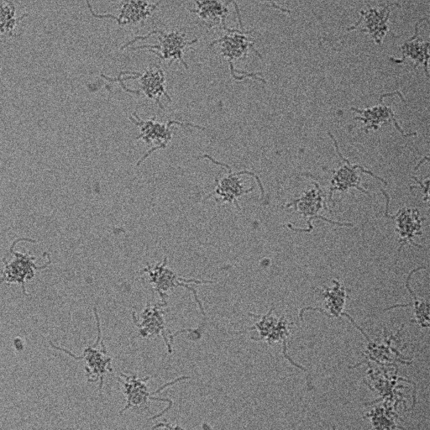
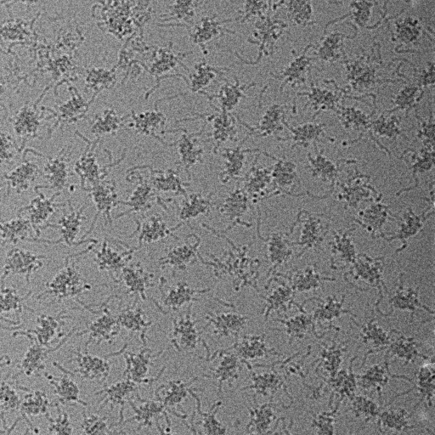
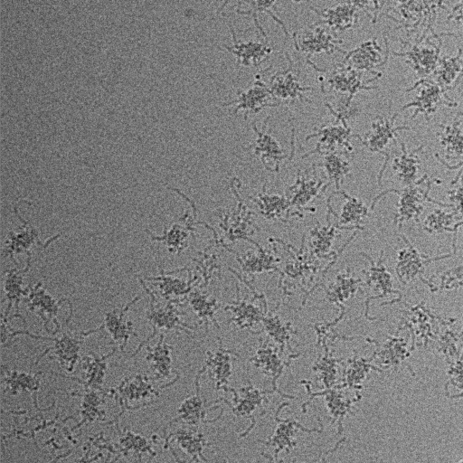
Pre-liminary screening for SBDS wt and SBDS-mutants (04072025)
500nM SBDS_wt-45nM 60S

Slide 2
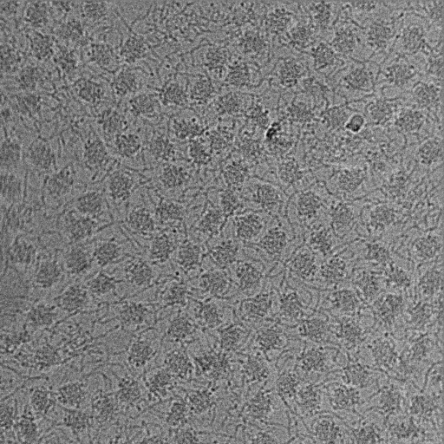
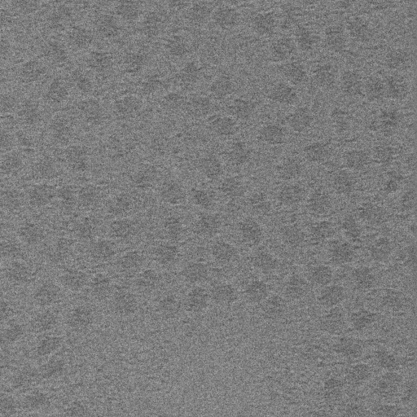
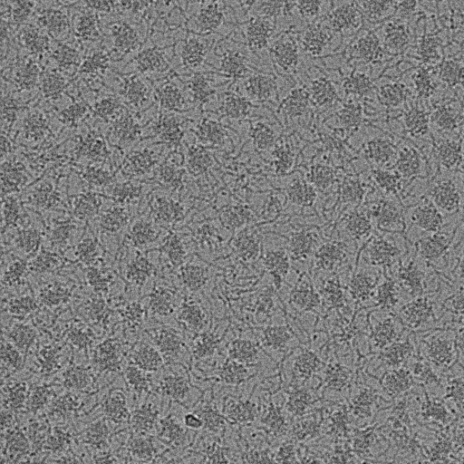
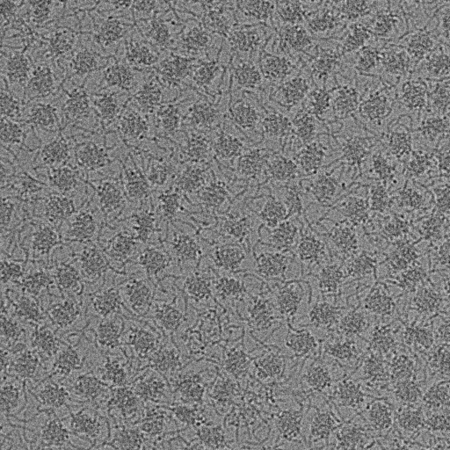
Pre-liminary screening for SBDS wt and SBDS-mutants (04072025)
500nM K33E-SBDS-45nM 60S

Slide 3
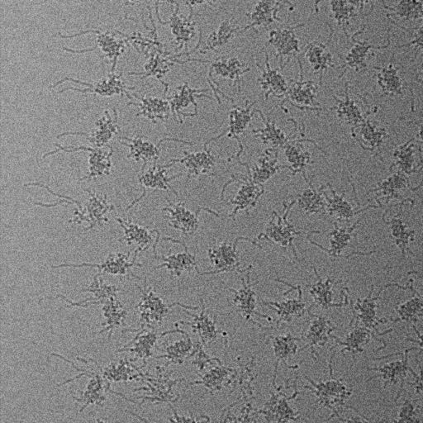
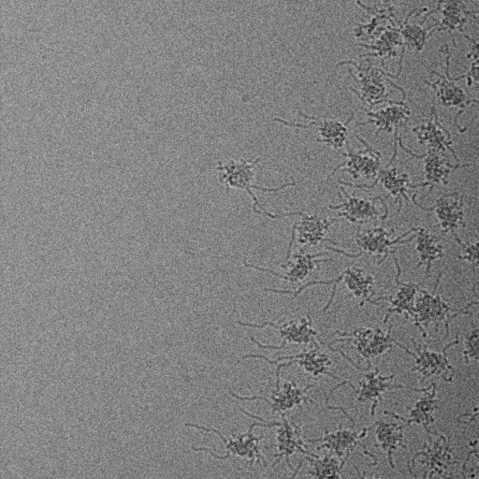
Pre-liminary screening for SBDS wt and SBDS-mutants (04072025)
500nM R126T-SBDS-45nM 60S

Slide 4
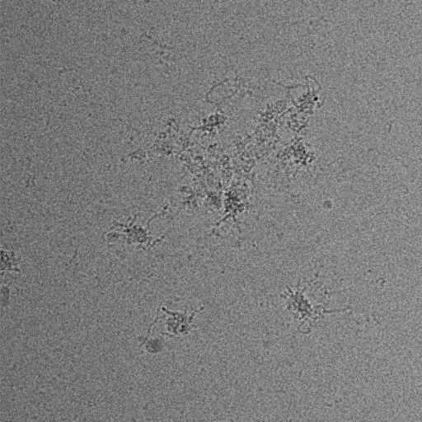
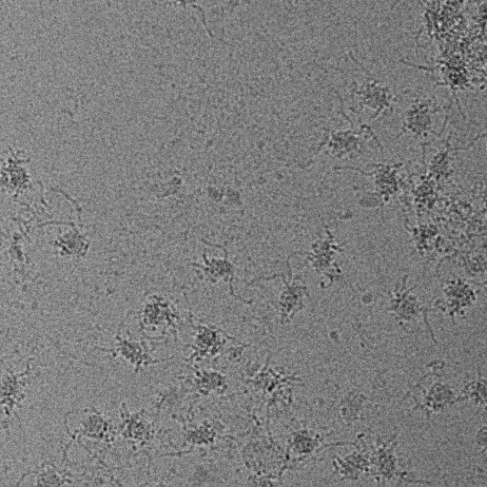
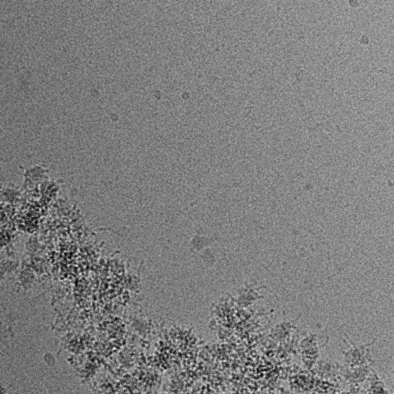
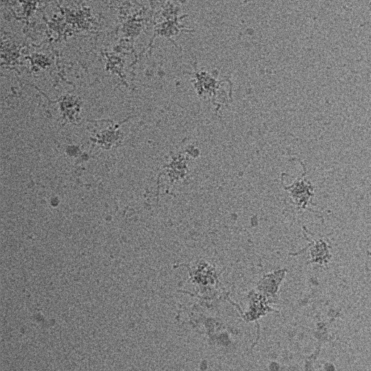
Pre-liminary screening for SBDS wt and SBDS-mutants (04072025)
500nM R175W-SBDS-45nM 60S
Please note that this mutation in SBDS is altering the properties of the ribosome.
This appears to result in the unfolding of the ribosome and causing some aggregation.
But, there are sufficient single ribosomal particles that might be used to get a structure.

Slide 5
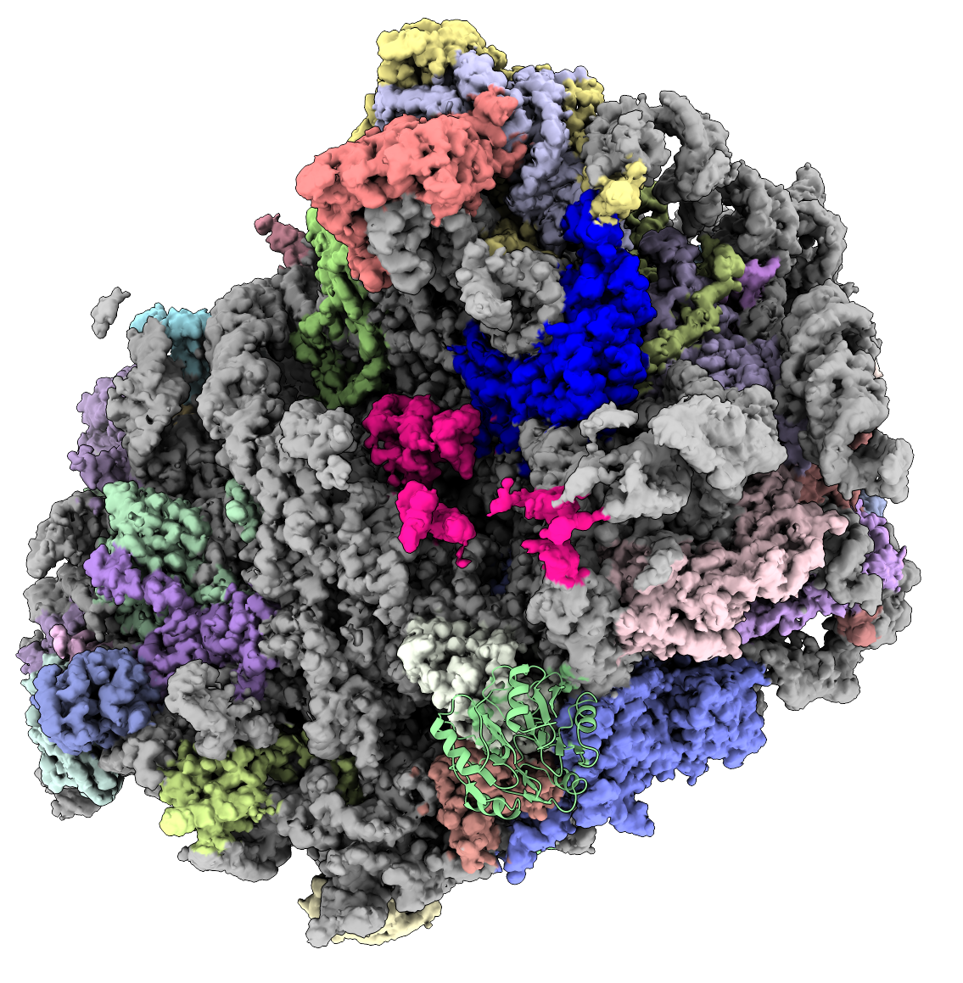
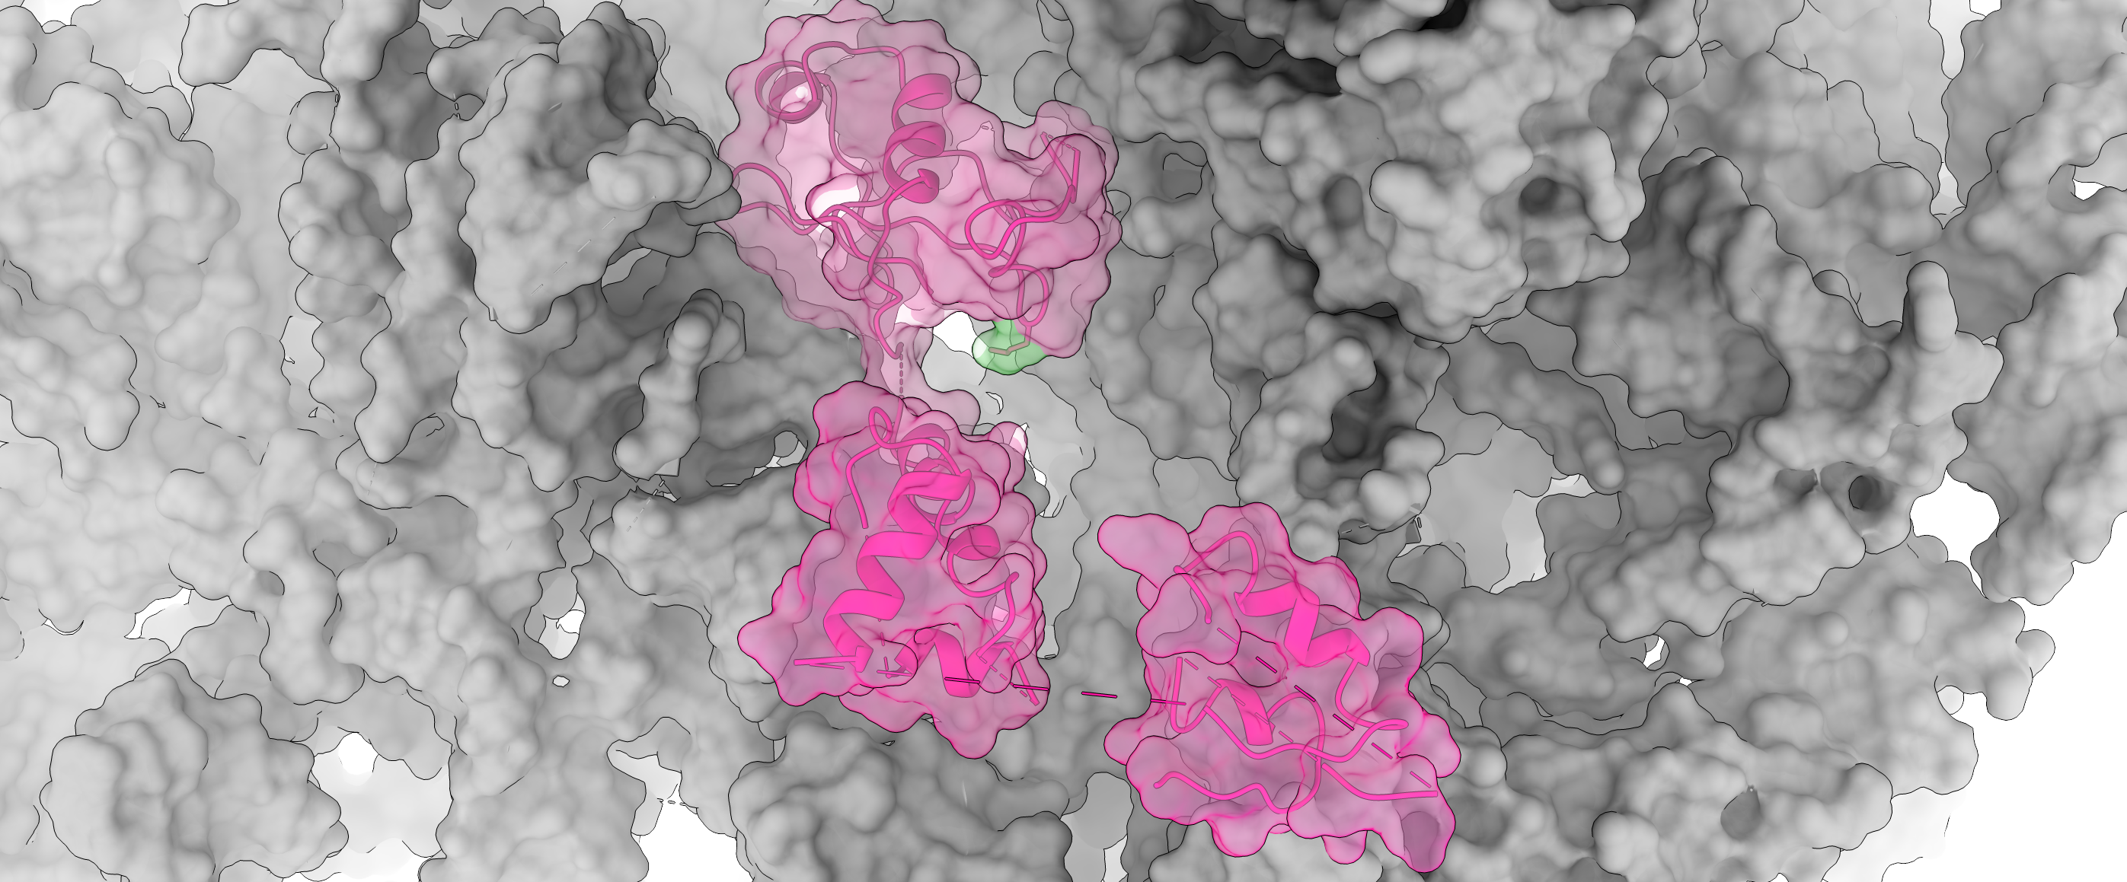
Structure of the human 60S ribosome complex bound to SBDS
SBDS bound to 60S is highlighted in magenta

