Slide 1
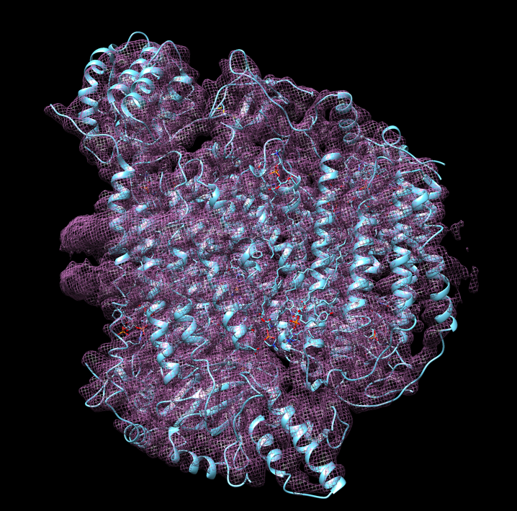
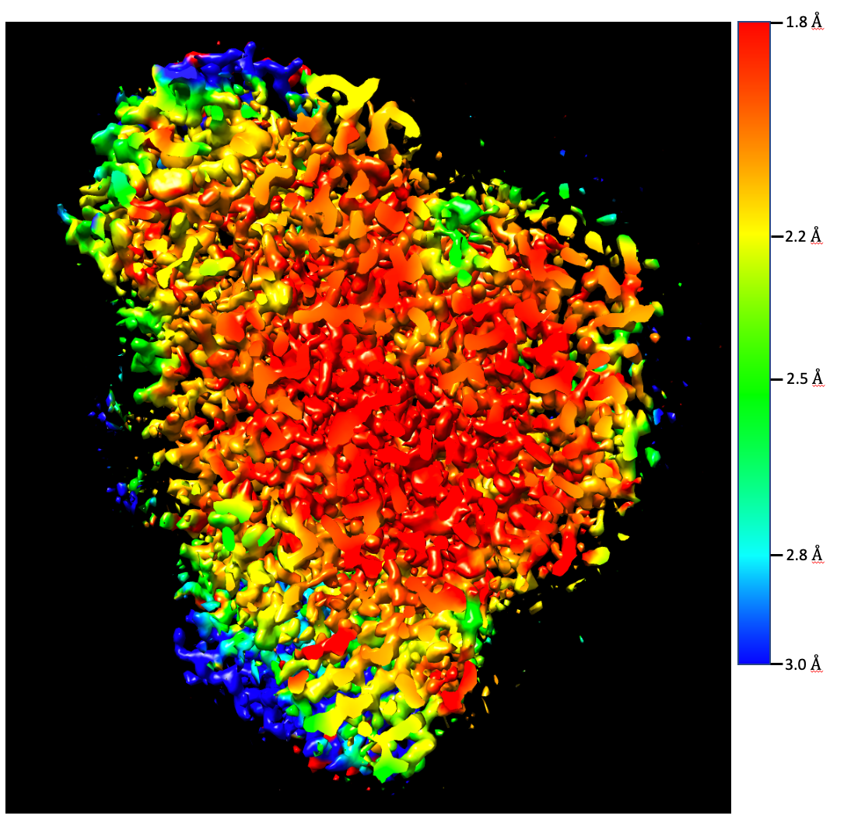
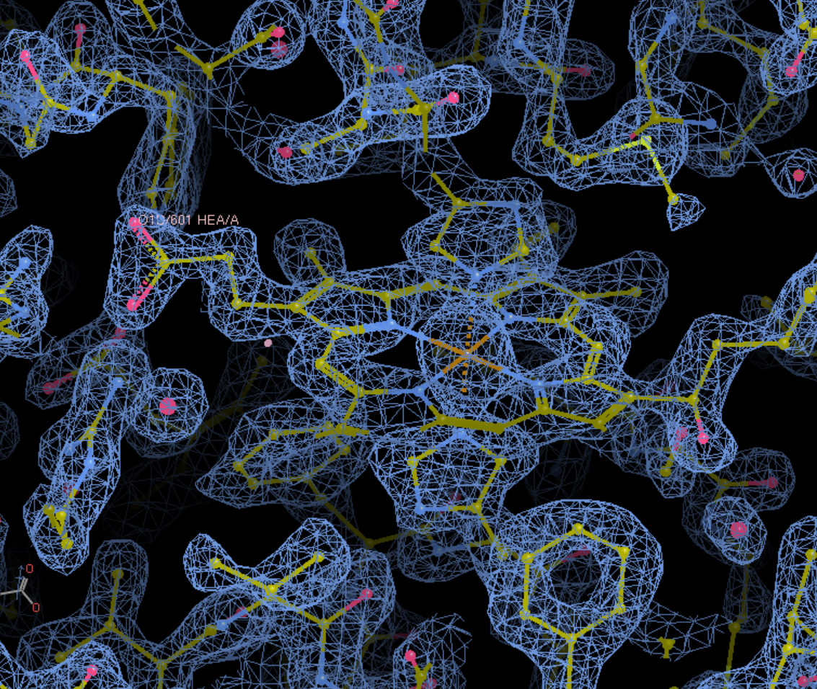
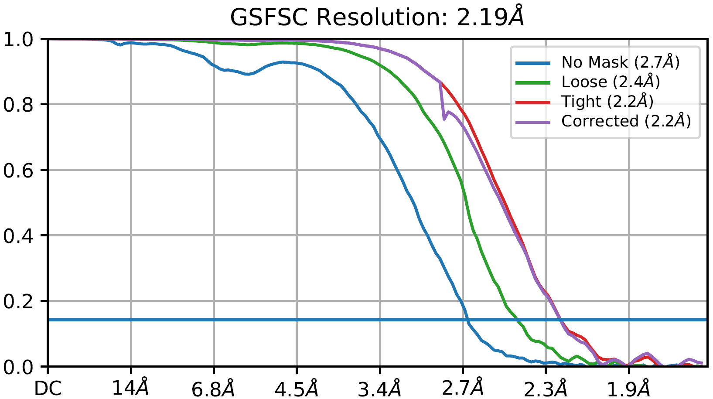
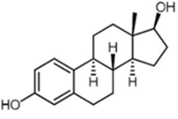
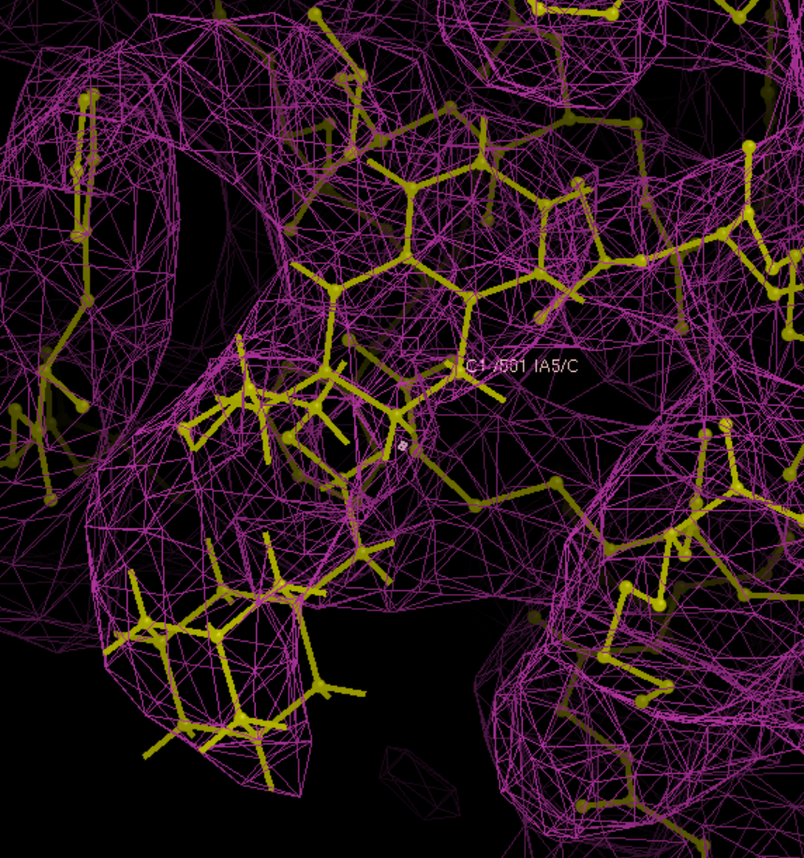
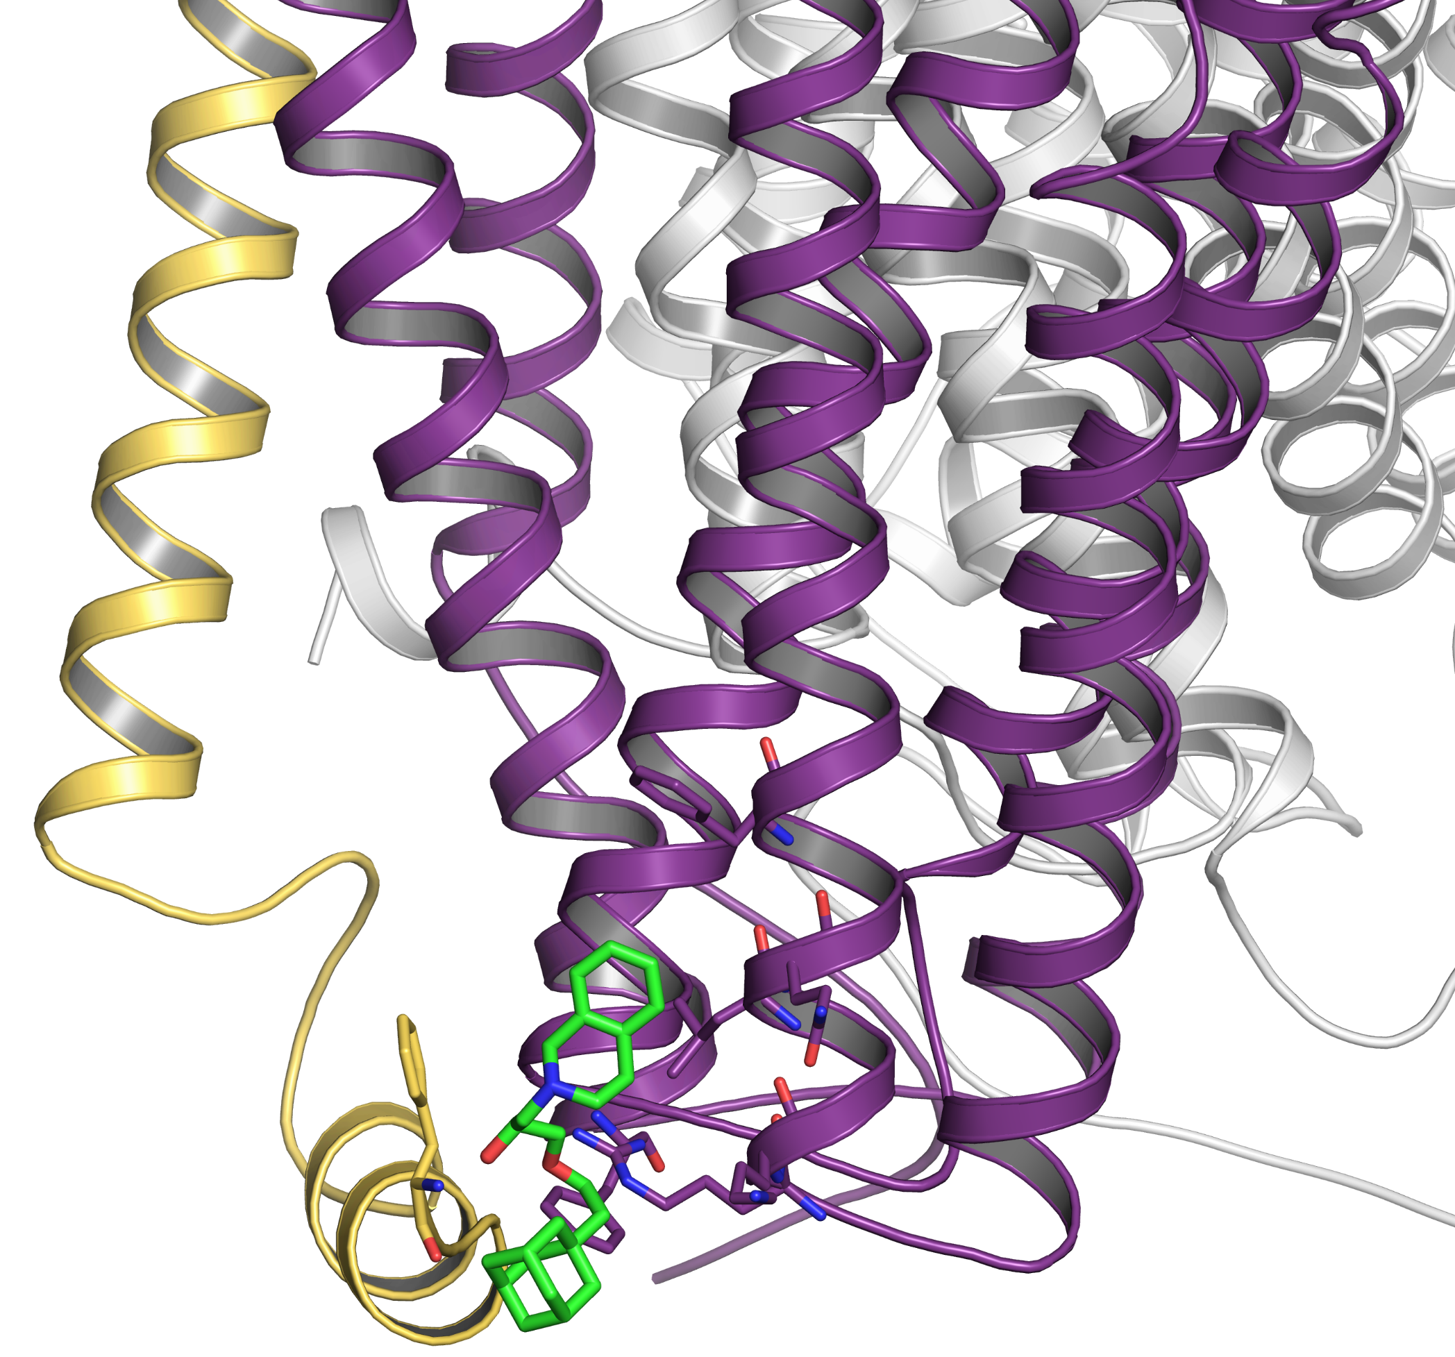
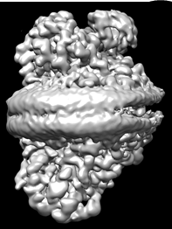
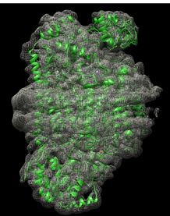
(A)
(B)
bCcO
(C)
1.8 Å
(D)
2.2 Å
H61
MSP^{1E3D1}
2.5 Å
H378
Heme a
2.8 Å
(E)
(F)
3.0 Å
GSFSC Resolution:
2.2 Å
Estradiol
Fig. 1. CryoEM structure of bCcO. (A-B) Electron density map of monomeric bCcO embedded in a nanodisc constructed with MSP^{1E3D1} and the modelled structure. (C) False color resolution image, showing the local resolution ranging from 1.8 to 3.0 Å. (D) A local view of the electron density map associated with the bCcO structure. (E) The Gold-standard FSC curves of the final 3D reconstruction. (F) Molecular structure of estradiol.
(A)
(B)
(C)
Cyt c
(D)
Cyt c
bCcO^{I}
bCcO
bCcO
bCcO^{III}
bCcO^{X}
ADDA 5
MSP^{1E3D1}
MSP^{1E3D1}
ADDA 5
Fig. 2. CryoEM structures of bCcO-ADDA 5 (A-B) and bCcO-Cyt c-complex (C-D). The averaged resolutions are 3.7 and 2.3 Å, respectively.

