Slide 1
Structural analyses of molecular machines in autophagy
Andrew Grassetti
Postdoctoral Associate
Davis Lab
MIT

Slide 2
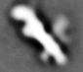
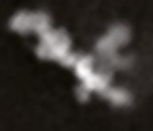
Autophagy overview and preliminary data
preliminary data
PMID: 31591221

