Slide 1
Structural studies of hypomodified ribosomes
Sohail Khoshnevis
Department of Biology, Emory University and
Department of Biochemistry, Emory University School of Medicine, Atlanta, GA

Slide 2
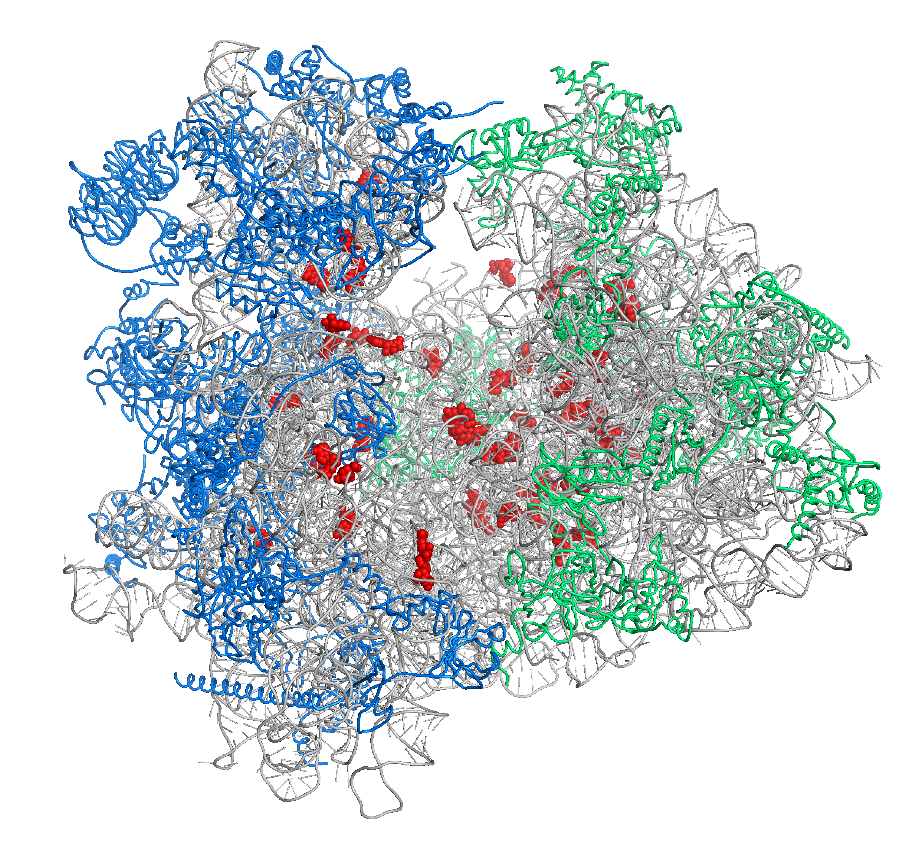
Ribosomal RNAs are post-transcriptionally modified at functionally important sites
Small subunit
Large subunit
Ben-Shem A. et al. (2011) Science, PDB:4V88

Slide 3
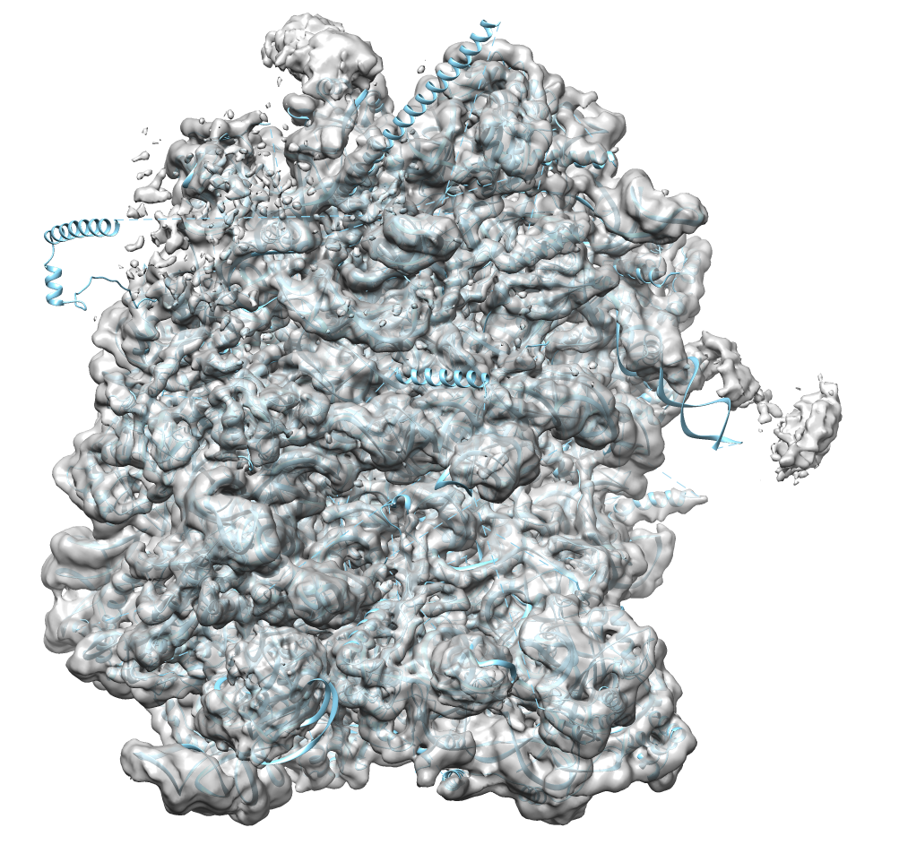
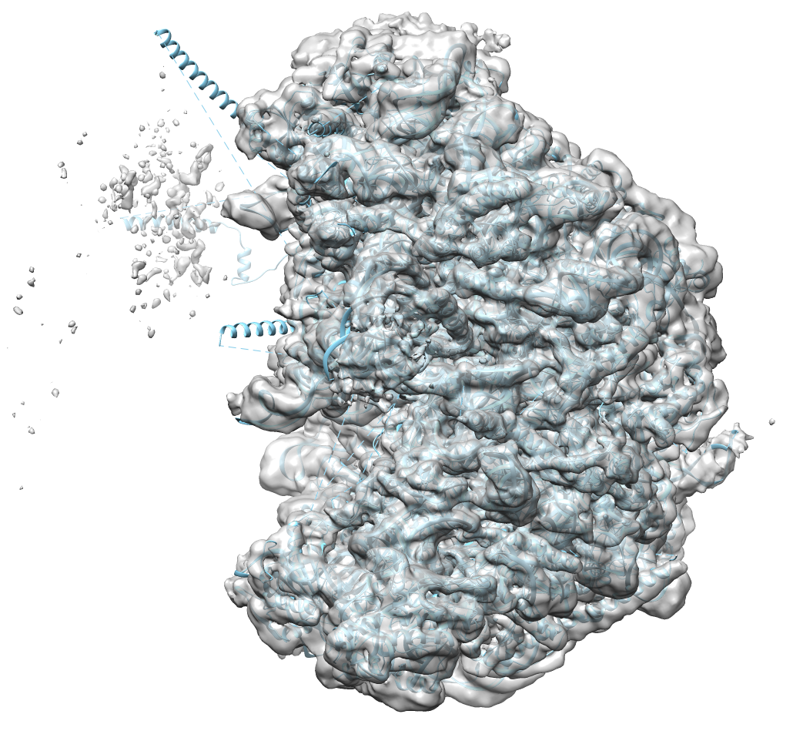
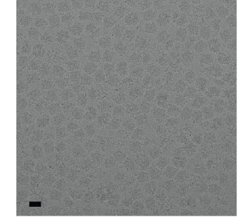
Hypomodification affects the function of ribosomes. But why?
A
B

