Slide 1
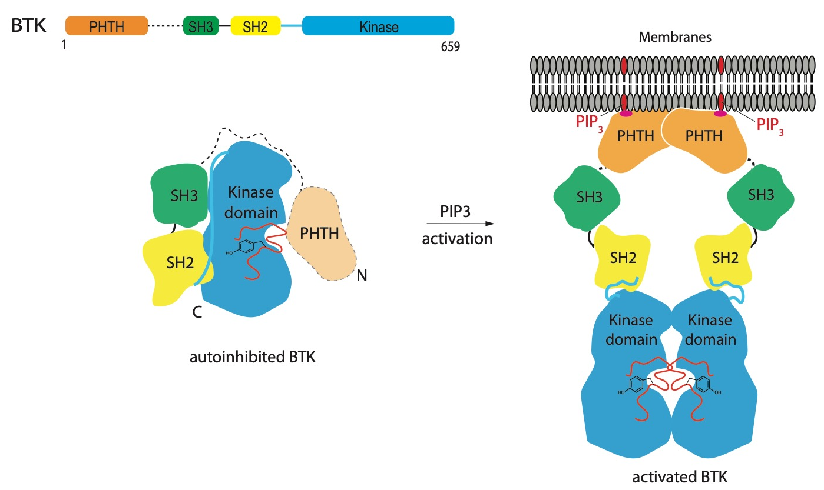
Models of Bruton’s tyrosine kinase (Btk) autoinhibition and activation

